Slide 1



KEYWORD EXTRACTION FOR
AUTO-TAGGING RESEARCH

Slide 2


Slide 3

AGENDA
Problem
Journey
Results
Next Steps
Learnings
Q&A

Slide 4

PROBLEM
STATEMENT

Slide 5


Notes:
Finding things is hard. Especially when it comes to digital things, such as JP Morgan’s Analyst reports. In order to find things, any search engine would have to qualify all of these reports, and index them. The engine would also need to understand how each report relates to another

Slide 6
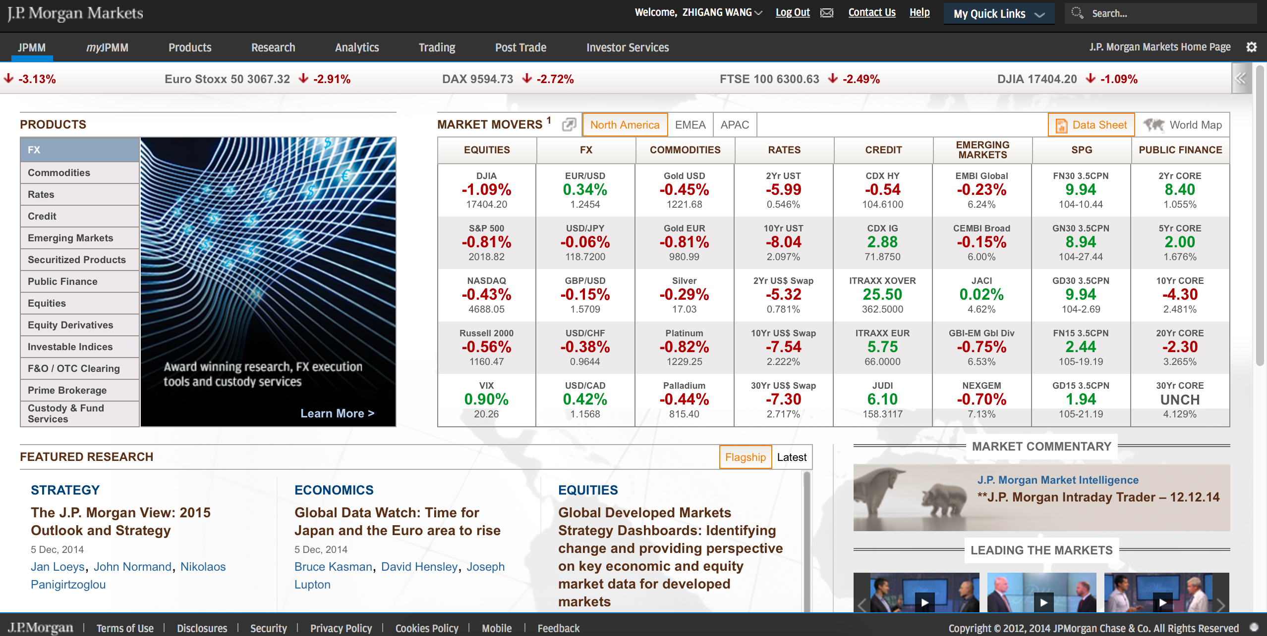
ANALYST REPORTS & JPMM
Oil and the global economy

Slide 7
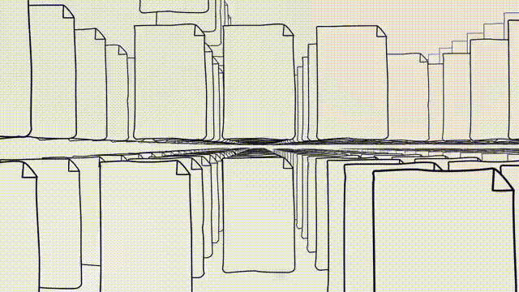

Notes:
-indexing the documents properly

Slide 8

Analysts today are forced to manually tag research docs.
They often don’t.
This makes search hard.

Slide 9
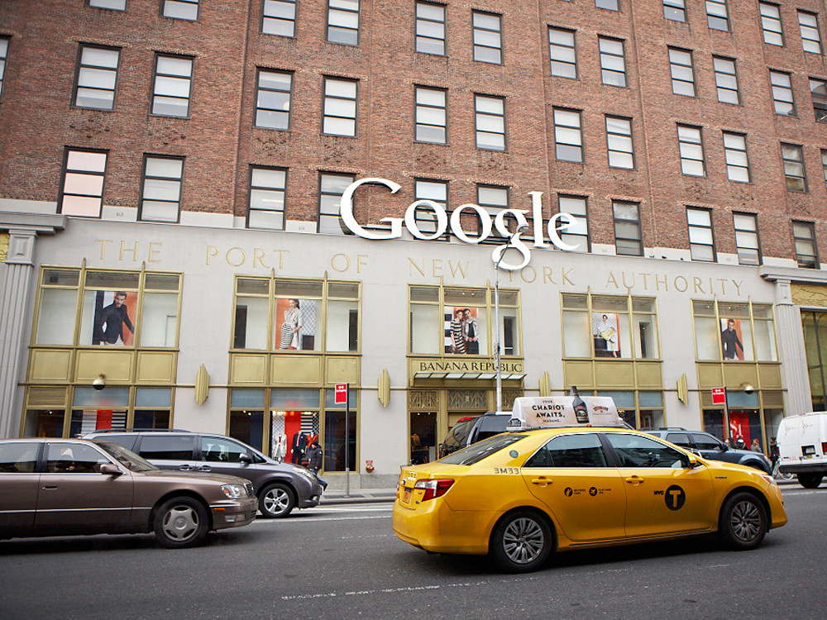
HACK DAY 1 - DISCOVERY

Slide 10
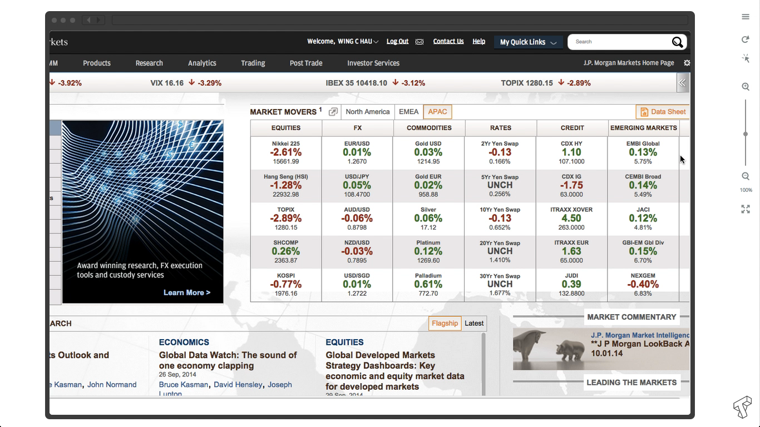
IN-LINE ADVANCED SEARCH UX
Notes:
Hack Day 1

Slide 11

HACK DAY 2 - EXPERIMENTATION

Slide 12
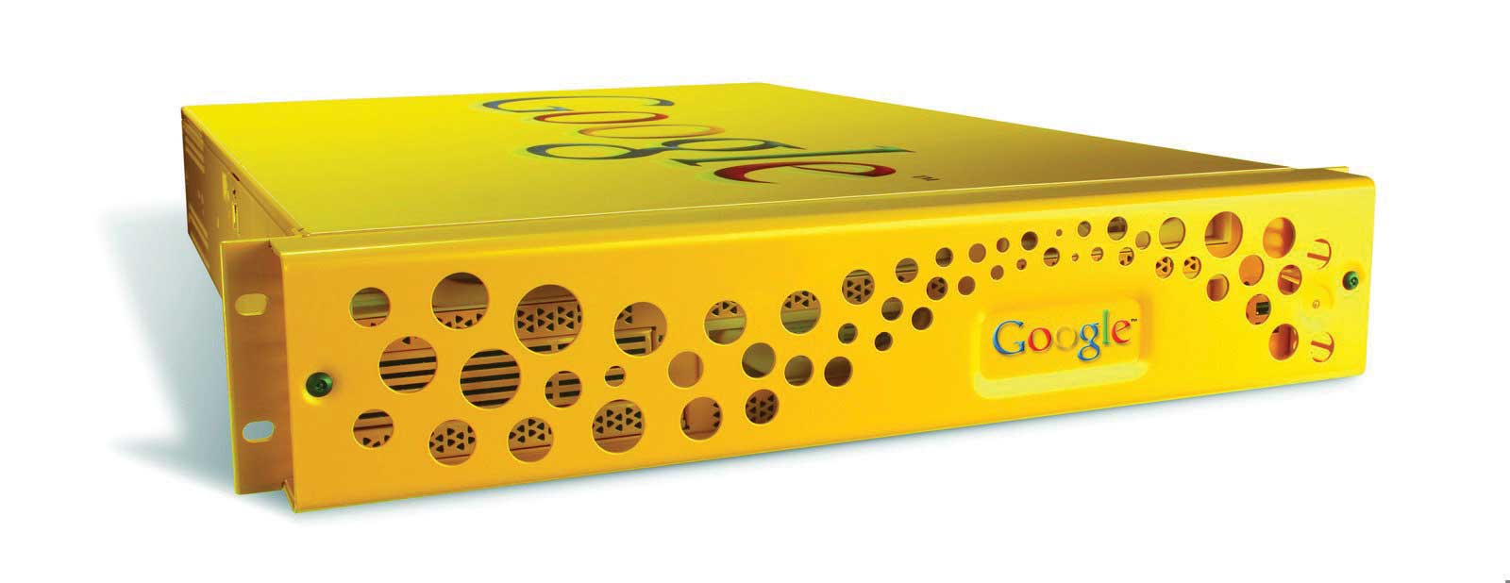
THE
GOOGLE SEARCH APPLIANCE
Notes:
Pros/Cons
Add details?

Slide 13

QUERY LOG ANALYSIS

Slide 14
QUERY LENGTH
Based on 222,317 queries in October 2014
Notes:
Hack Day 2
222,317 non-blank search terms
0.0631170805651 complex search terms (6.3%)

Slide 15
UNIGRAM FREQUENCY

Slide 16
BIGRAM FREQUENCY

Slide 17
TRIGRAM FREQUENCY

Slide 18
TETRAGRAM FREQUENCY

Slide 19

NATURAL LANGUAGE PROCESSING
Named Entity Recognition
Term Frequency/Inverse Document Frequency

Slide 20

HACK DAY 3 - DEVELOPMENT
Notes:
Change image?

Slide 21


CREATE NEW ANALYST REPORT
Notes:
Right now, how do these reports get created and put into JPMM?

Slide 22
WRITE ANALYST REPORT
J.P.Morgan
North America Equity Research
December 15, 2014

Slide 23
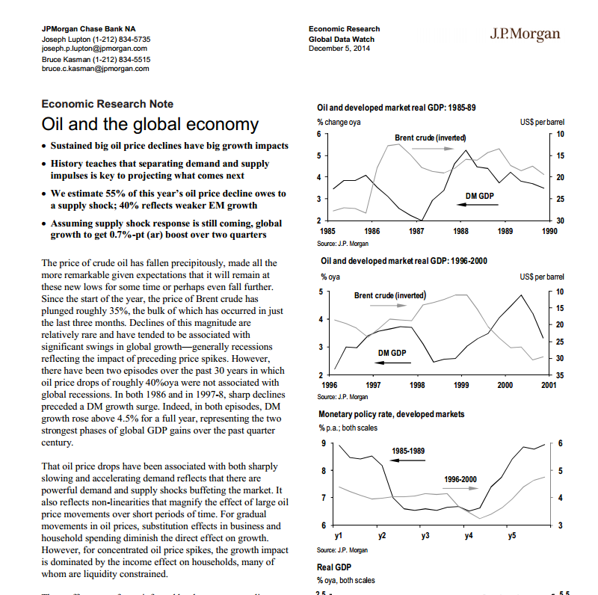
MANUALLY TAG THE DOCUMENT
Oil
Oil X
Economic X
Economic
Price
Price X

Slide 24

PUBLISH ANALYST REPORT
J.P.Morgan

Slide 25

Auto Tag Recommendation
API
Create New Analyst Report
Write
Analyst
Report
Manually
Tag
Report
Publish
Report

Slide 26
AUTO TAGGING API
Notes:
What does our API do?

Slide 27
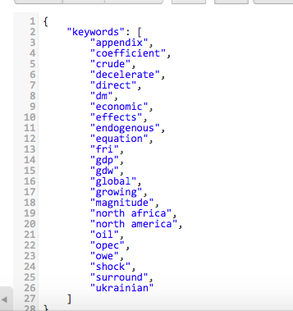
AUTO TAGGING API
KEYWORD EXTRACTION
J.P.Morgan
Oil
economic
GDP
OPEC
North Africa
North America

Slide 28
J.P.Morgan
KEYWORD EXTRACTION API
Authors
Oil
Companies
economic
Industries
OPEC X
GDP
Subjects
Oil X
GDP X
OPEC
North Africa
Countries
North America
Regions
North America X
North Africa X

Slide 29
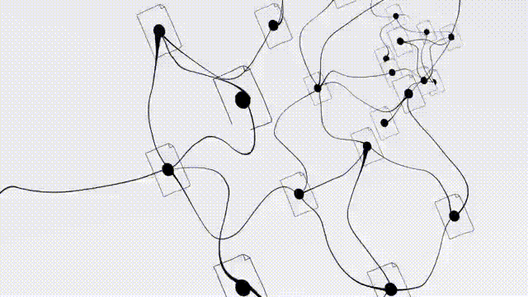


Slide 30

IMPACT TO JPMC
Notes:
Time saver – JPMC analysts don’t have to take time to think about
Accuracy – improves accuracy of search results
Relative – easier to understand related document

Slide 31
IMPACT TO JPMC
Time savings: Improve quality of tagging with minimal effort from analysts
Better search results: Tagged documents are better indexed by JPMM’s search engine
Retroactively tag historical docs: Old documents could be run through the API
Groundwork for future apps: Use for custom research streams widget
Notes:
Precision of 10 (address Vic/Sue
Typically google has precision of 7.5
Do trials with 30 users, vary the weights
Another area that we investigated

Slide 32

Use NLP to extract valuable
business insights
Notes:
JP Morgan is one of several organizations that produces research reports. Millions of them.

Slide 33

NEXT STEPS
Transfer documentation and API
UI widget for custom research streams
Precision of 10 for improving results
Notes:
Precision of 10 (address Vic/Sue
Typically google has precision of 7.5
Do trials with 30 users, vary the weights
Another area that we investigated

Slide 34

LESSONS LEARNED
Quick iteration to tackle a problem from several approaches
Learned NLP and search
MBAs and CS cross-teaching each other
Defining scope of a complex problem

Slide 35

THANK YOU

Slide 36
APPENDIX

